Slide 1
Introduction to Secure Coding

Slide 2
Common Vulnerabilities and Exposures (CVE)
A list of publicly disclosed information security vulnerabilities
and exposures
CVE was launched in 1999 by the MITRE corporation to identify and categorize vulnerabilities in software and firmware.
CVE provides a free dictionary for organizations to improve their cyber security.
MITRE is a nonprofit that operates federally funded research and development centers in the United States.

Slide 3
Vulnerability
A vulnerability is a weakness which can be exploited in a cyber attack to gain unauthorized access to or perform unauthorized actions on a computer system. Vulnerabilities can allow attackers to run code, access system memory, install different types of malware and steal, destroy or modify sensitive data.

Slide 4
Sensitive PII
The following PII is always (de facto) sensitive, with or without any associated personal information, and cannot be treated as low confidentiality:
Social Security number (SSN)
Passport number
Driver’s license number
Vehicle Identification Number (VIN)
Biometrics, such as finger or iris print, and DNA
Financial account number such as credit card or bank account number
The combination of any individual identifier and date of birth, or mother’s maiden name, or last four of an individual’s SSN
The following information is Sensitive PII when associated with an individual:
Account passwords
Criminal history
Ethnic or religious affiliation
Last 4 digits of SSN
Mother’s maiden name
Medical Information
Sexual orientation

Slide 5
Sensitive PII (continued)
In addition to de facto Sensitive PII, some PII may be deemed sensitive based on context. For example, a list of employee names is not Sensitive PII; however, a list of employees’ names and their performance rating would be considered Sensitive PII.
The following PII is not sensitive alone or in combination unless documented with sensitive qualifying information and may be treated as low confidentiality:
Name
Professional or personal contact information including email, physical address, phone number and fax number
Federal employee name, work contact information, grade, salary and position are considered PII. Except for limited circumstances, this information is publically available and is not considered sensitive.

Slide 6
Vulnerabilities, Threats, and Controls
Understanding Vulnerabilities, Threats, and Controls
Vulnerability = a weakness in a security system
Threat = circumstances that have a potential to cause harm
Controls = means and ways to block a threat, which tries to exploit one or more vulnerabilities
Most of the class discusses various controls and their effectiveness
[Pfleeger & Pfleeger]
Example - New Orleans disaster (Hurricane Katrina)
Q: What were city vulnerabilities, threats, and controls?
A: Vulnerabilities: location below water level, geographical location in hurricane area, …
Threats: hurricane, dam damage, terrorist attack, …
Controls: dams and other civil infrastructures, emergency response
plan, …

Slide 7
Vulnerabilities, Threats, and Controls
Understanding Vulnerabilities, Threats, and Controls
Vulnerability = a weakness in a security system
Threat = circumstances that have a potential to cause harm
Controls = means and ways to block a threat, which tries to exploit one or more vulnerabilities
Most of the class discusses various controls and their effectiveness
[Pfleeger & Pfleeger]
Example - New Orleans disaster (Hurricane Katrina)
Q: What were city vulnerabilities, threats, and controls?
A: Vulnerabilities: location below water level, geographical location in hurricane area, …
Threats: hurricane, dam damage, terrorist attack, …
Controls: dams and other civil infrastructures, emergency response
plan, …

Slide 8
Cryptographic Hashes
Invented because public key is slow
Slow to sign a huge msg using a private key
Cryptographic hash
fixed size (e.g., 160 bits)
But no collisions! (at least we’ll never find one)
So sign the hash, not the actual msg
If you sign a msg, you’re signing all msgs with that hash!

Slide 9
Hash stuff
Most popular hash today SHA-1 (secure hash algorithm)
Older ones (MD2, MD4, MD5) still around
Popular secret-key integrity check: hash together key and data
One popular standard for that within IETF: HMAC

Slide 10
Controls: Encryption
Primary controls!
Cleartext scambled into ciphertext (enciphered text)
Protects CIA:
confidentiality – by „masking” data
integrity – by preventing data updates
e.g., checksums included
availability – by using encryption-based protocols
e.g., protocols ensure availablity of resources for different users

Slide 11
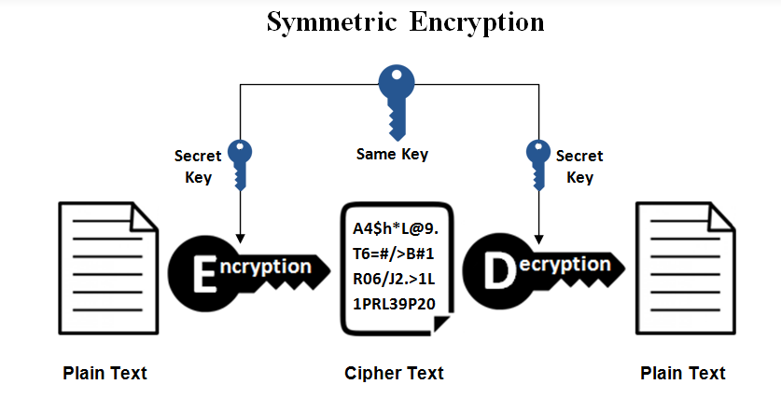
Notes:
This is the simplest kind of encryption that involves only one secret key to cipher and decipher information. Symmetric encryption is an old and best-known technique. It uses a secret key that can either be a number, a word or a string of random letters. It is a blended with the plain text of a message to change the content in a particular way. The sender and the recipient should know the secret key that is used to encrypt and decrypt all the messages. Blowfish, AES, RC4, DES, RC5, and RC6 are examples of symmetric encryption. The most widely used symmetric algorithm is AES-128, AES-192, and AES-256.
The main disadvantage of the symmetric key encryption is that all parties involved have to exchange the key used to encrypt the data before they can decrypt it.

Slide 12
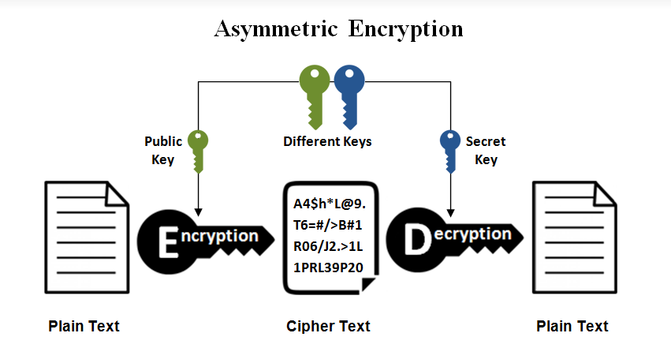
Notes:
Asymmetric encryption is also known as public key cryptography, which is a relatively new method, compared to symmetric encryption. Asymmetric encryption uses two keys to encrypt a plain text. Secret keys are exchanged over the Internet or a large network. It ensures that malicious persons do not misuse the keys. It is important to note that anyone with a secret key can decrypt the message and this is why asymmetric encryption uses two related keys to boosting security. A public key is made freely available to anyone who might want to send you a message. The second private key is kept a secret so that you can only know.
A message that is encrypted using a public key can only be decrypted using a private key, while also, a message encrypted using a private key can be decrypted using a public key. Security of the public key is not required because it is publicly available and can be passed over the internet. Asymmetric key has a far better power in ensuring the security of information transmitted during communication.
Asymmetric encryption is mostly used in day-to-day communication channels, especially over the Internet. Popular asymmetric key encryption algorithm includes EIGamal, RSA, DSA, Elliptic curve techniques, PKCS.

Slide 13
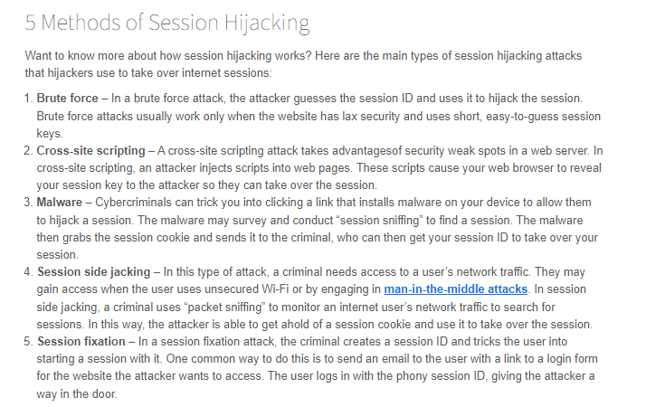

Slide 14
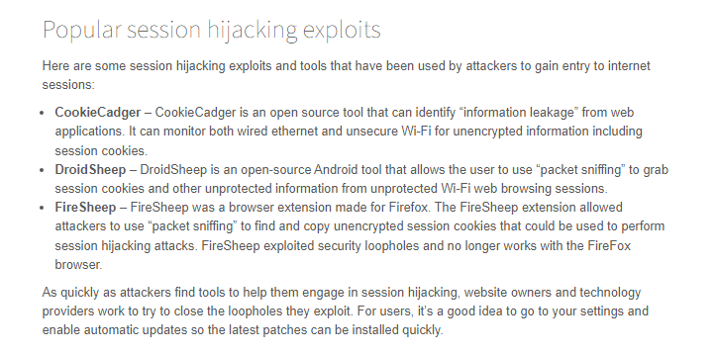

Slide 15
Eavesdropping
An Eavesdropping attack only passively observe messages.
Protocols defend against Eavesdropping attacks by using encryption for confidentiality.
The attacker is a passive outsider.

Slide 16
Heartbleed and Openssl Vulnerabilities
Even with a large number of organizations using OpenSSL, OpenSSL vulnerabilities and security was mostly overlooked until the heartbleed vulnerability which was disclosed in April 2014.
Unlike other vulnerabilities in the past, heartbleed attack can steal the private/secret key of an SSL certificate without having any privileged access to the server.
Keys stolen with the heartbleed vulnerability could be used to decrypt all encrypted communication between the server and client. This led to a lot of panic since any stolen private keys could be used to decrypt communication even after patching the affected openssl version/server.
As a result of this, all certificates(installed on affected servers) had to be re issued with a new private key.

Slide 17
Heartbleed and Openssl Vulnerabilities
Even with a large number of organizations using OpenSSL, OpenSSL vulnerabilities and security was mostly overlooked until the heartbleed vulnerability which was disclosed in April 2014.
Unlike other vulnerabilities in the past, heartbleed attack can steal the private/secret key of an SSL certificate without having any privileged access to the server.
Keys stolen with the heartbleed vulnerability could be used to decrypt all encrypted communication between the server and client. This led to a lot of panic since any stolen private keys could be used to decrypt communication even after patching the affected openssl version/server.
As a result of this, all certificates(installed on affected servers) had to be re issued with a new private key.

Slide 18
POODLE
With POODLE attack, an attacker could decrypt the content transferred over an SSLv3 connection. POODLE attacks make use of the web browsers’ and servers’ fallback to SSLv3 in case of issues with negotiating a TLS session and the attacker could in turn exploit the vulnerability in SSLv3.

Slide 19
POODLE
With POODLE attack, an attacker could decrypt the content transferred over an SSLv3 connection. POODLE attacks make use of the web browsers’ and servers’ fallback to SSLv3 in case of issues with negotiating a TLS session and the attacker could in turn exploit the vulnerability in SSLv3.

Slide 20
CRIME Attack
The CRIME attack is a vulnerability in the compression of the Secure Sockets Layer (SSL)/Transport Layer Security (TLS) protocols and the SPDY protocol. The abbreviation stands for Compression Ratio Info-leak Made Easy.
This type of risk constitutes an attack against secret web cookies sent over connections through compressed HTTPS for SSL/TLS protocols or SPDY, Google’s HTTP-like protocol. The attack can leave cookie data vulnerable to session hijacking.

Slide 21
BREACH attack
To beat encryption, the BREACH attack targets the implementation of HTTP responses using HTTP compression, which is critical to many enterprises because it minimizes bandwidth costs and speeds up webpage load times.
The BREACH attack steals information about how data is encrypted from HTTPS-enabled Web applications by essentially combining two existing types of attacks: using cross-site request forgery (CSRF) to change data in transport, and injecting data into the HTTPS headers using a man-in-the-middle attack. The response to these requested changes, based on the injected data, allows attackers to determine the secret used for the encryption of the session one byte at a time, which can then be used to decrypt the data.
While static websites are at low risk for these attacks, full-featured Web applications are highly vulnerable due to the fact that they are designed to accept input from the Web client, making it much easier to measure changes in the webpages served by the Web application and eventually decrypt the connection. Though the practical implications for the attack technique on the server side are minimal, on the client side, updates must be made to prevent man-in-the-middle attacks. Fortunately, this attack may not work against other protocols that use SSL/TLS for transport layer encryption like SSL-SMTP or IMAPS.

Slide 22
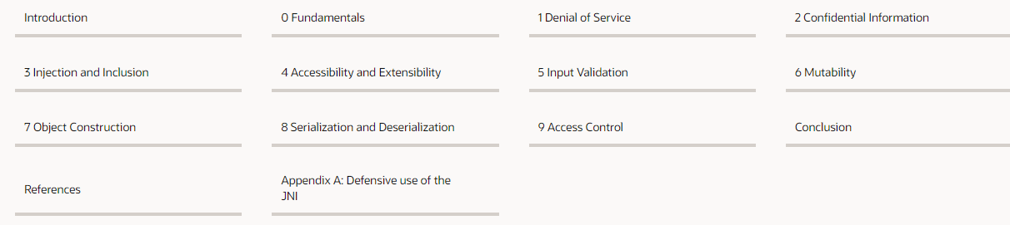
Secure Coding Guidelines for Java SE
https://www.oracle.com/java/technologies/javase/seccodeguide.html

Slide 23
What Is Secure Software and Secure Coding Standards?
https://www.perforce.com/blog/qac/secure-coding-standards#what-are
Secure software is software that has been developed in such a way that it will continue to function normally even when subjected to malicious attacks.
This helps to ensure the security of software by:
Managing access control
Providing data protection
Safeguarding against viruses and other cybersecurity vulnerabilities
An essential part of security software is secure coding and using the right software security tool

Slide 24
OWASP Top 10 Application T10 Security Risks – 2013
A1 – Injection: Injection flaws, such as SQL, OS, and LDAP injection occur when untrusted data is sent to an interpreter as part of a command or query. The attacker’s hostile data can trick the interpreter into executing unintended commands or accessing data without proper authorization.
A2 – Broken Authentication and Session Management : Application functions related to authentication and session management are often not implemented correctly, allowing attackers to compromise passwords, keys, or session tokens, or to exploit other implementation flaws to assume other users’ identities.

Slide 25
OWASP Top 10 Application T10 Security Risks – 2013
A3 – Cross-Site Scripting (XSS): XSS flaws occur whenever an application takes untrusted data and sends it to a web browser without proper validation or escaping. XSS allows attackers to execute scripts in the victim’s browser which can hijack user sessions, deface web sites, or redirect the user to malicious sites.
A4 – Insecure Direct Object References: A direct object reference occurs when a developer exposes a reference to an internal implementation object, such as a file, directory, or database key. Without an access control check or other protection, attackers can manipulate these references to access unauthorized data.

Slide 26
OWASP Top 10 Application T10 Security Risks – 2013
A5 – Security Misconfiguration: Good security requires having a secure configuration defined and deployed for the application, frameworks, application server, web server, database server, and platform. Secure settings should be defined, implemented, and maintained, as defaults are often insecure. Additionally, software should be kept up to date.
A6 – Sensitive Data Exposure: Many web applications do not properly protect sensitive data, such as credit cards, tax IDs, and authentication credentials. Attackers may steal or modify such weakly protected data to conduct credit card fraud, identity theft, or other crimes. Sensitive data deserves extra protection such as encryption at rest or in transit, as well as special precautions when exchanged with the browser.

Slide 27
OWASP Top 10 Application T10 Security Risks – 2013
A7 – Missing Function Level Access Control: Most web applications verify function level access rights before making that functionality visible in the UI. However, applications need to perform the same access control checks on the server when each function is accessed. If requests are not verified, attackers will be able to forge requests in order to access functionality without proper authorization.
A8 - Cross-Site Request Forgery (CSRF): A CSRF attack forces a logged-on victim’s browser to send a forged HTTP request, including the victim’s session cookie and any other automatically included authentication information, to a vulnerable web application. This allows the attacker to force the victim’s browser to generate requests the vulnerable application thinks are legitimate requests from the victim.

Slide 28
OWASP Top 10 Application T10 Security Risks – 2013
A9 - Using Components with Known Vulnerabilities: Components, such as libraries, frameworks, and other software modules, almost always run with full privileges. If a vulnerable component is exploited, such an attack can facilitate serious data loss or server takeover. Applications using components with known vulnerabilities may undermine application defenses and enable a range of possible attacks and impacts.
A10 – Unvalidated Redirects and Forwards: Web applications frequently redirect and forward users to other pages and websites, and use untrusted data to determine the destination pages. Without proper validation, attackers can redirect victims to phishing or malware sites, or use forwards to access unauthorized pages.

Slide 29
What does Owasp test?
OWASP pen testing describes the assessment of web applications to identify vulnerabilities outlined in the OWASP Top Ten. An OWASP pen test is designed to identify, safely exploit and help address these vulnerabilities so that any weaknesses discovered can be quickly addressed.

